Slide 1


CSE101 Intro to CS and Programming
Boolean Algebra and Logic Circuits
Lecture 11 (Week 6)
By Mr. Faheem Shaukat
faheem@iqraisb.edu.pk

Slide 2
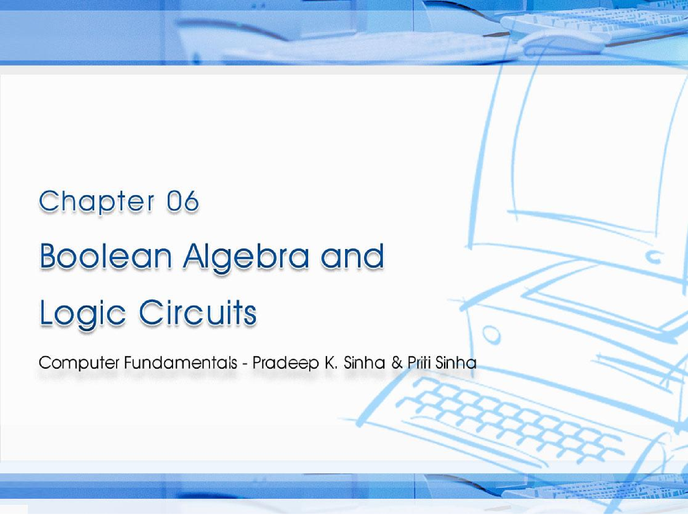

CCoommppuutterer FFununddaammenenttaallss:: PPrradadeeepep KK.. SSiinhanha && PPrriititi SSiinhanha
Ref. Page Chapter 6: Boolean Algebra and Logic Circuits Slide 1/78

Slide 3
Learning Objectives
Computer Fundamentals: Pradeep K. Sinha & Priti Sinha
In this chapter you will learn about:
Fundamental concepts and basic laws of Boolean algebra
Boolean function and minimization
Logic gates
Logic circuits and Boolean expressions
60
Slide 3/78

Slide 4
Fundamental Concepts of Boolean Algebra
Computer Fundamentals: Pradeep K. Sinha & Priti Sinha
Use of Binary Digit
Boolean equations can have either of two possible values, 0 and 1
Logical Addition
Symbol ‘+’, also known as ‘OR’ operator, used for logical addition. Follows law of binary addition
Logical Multiplication
Symbol ‘.’, also known as ‘AND’ operator, used for logical multiplication. Follows law of binary multiplication
Complementation
Symbol ‘-’, also known as ‘NOT’ operator, used for complementation. Follows law of binary compliment
61
Slide 4/78

Slide 5
Operator Precedence
Computer Fundamentals: Pradeep K. Sinha & Priti Sinha
Higher the operator’s precedence level, earlier it is evaluated
Expression is scanned from left to right
First, expressions enclosed within parentheses are evaluated
Then, all complement (NOT) operations are performed
Then, all ‘⋅’ (AND) operations are performed
Finally, all ‘+’ (OR) operations are performed
(Continued on next slide)
62
Slide 5/78

Slide 6
Computer Fundamentals: Pradeep K. Sinha & Priti Sinha
Operator Precedence
(Continued from previous slide..)
X + Y ⋅ Z
₁st
₂nd
₃rd
62
Slide 6/78

Slide 7
Boolean Functions
Computer Fundamentals: Pradeep K. Sinha & Priti Sinha
A Boolean function is an expression formed with:
Binary variables
Operators (OR, AND, and NOT)
Parentheses, and equal sign
The value of a Boolean function can be either 0 or 1
A Boolean function may be represented as:
An algebraic expression,
A truth table
Logical Circuit
67

Slide 8
Representation as an Algebraic Expression
Computer Fundamentals: Pradeep K. Sinha & Priti Sinha
W = X + Y ·Z
Variable W is a function of X, Y, and Z, can also be written as W = f (X, Y, Z)
The RHS of the equation is called an expression
The symbols X, Y, Z are the literals of the function
For a given Boolean function, there may be more than one algebraic expressions
67

Slide 9
Representation as a Truth Table
Computer Fundamentals: Pradeep K. Sinha & Priti Sinha
X | Y | Z | W
0 | 0 | 0 | 0
0 | 0 | 1 | 1
0 | 1 | 0 | 0
0 | 1 | 1 | 0
1 | 0 | 0 | 1
1 | 0 | 1 | 1
1 | 1 | 0 | 1
1 | 1 | 1 | 1
(Continued on next slide)
67

Slide 10
Representation as a Truth Table
Computer Fundamentals: Pradeep K. Sinha & Priti Sinha
(Continued from previous slide..)
The number of rows in the table is equal to 2^{n}, where
n is the number of literals in the function
The combinations of 0s and 1s for rows of this table are obtained from the binary numbers by counting from 0 to 2^{n} - 1
67

Slide 11
Logic Gates
Computer Fundamentals: Pradeep K. Sinha & Priti Sinha
Logic gates are electronic circuits that operate on one or more input signals to produce standard output signal
Are the building blocks of all the circuits in a computer
Some of the most basic and useful logic gates are AND, OR, NOT, NAND and NOR gates
77

Slide 12
AND Gate
Computer Fundamentals: Pradeep K. Sinha & Priti Sinha
Physical operation
realization
of logical
multiplication
(AND)
Generates an output signal signals are also 1
of 1 only if all input
77

Slide 13
AND Gate (Block Diagram Symbol and Truth Table)
Computer Fundamentals: Pradeep K. Sinha & Priti Sinha
A B
C = A ⋅ B
Inputs |  | Output
A | B | C = A ⋅ B
0 | 0 | 0
0 | 1 | 0
1 | 0 | 0
1 | 1 | 1
77

Slide 14
OR Gate
Computer Fundamentals: Pradeep K. Sinha & Priti Sinha
Physical realization of logical addition (OR) operation
Generates an output signal of 1 if at least one of the input signals is also 1
77

Slide 15
OR Gate (Block Diagram Symbol and Truth Table)
Computer Fundamentals: Pradeep K. Sinha & Priti Sinha
A
B
C = A + B
Inputs |  | Output
A | B | C = A + B
0 | 0 | 0
0 | 1 | 1
1 | 0 | 1
1 | 1 | 1
78

Slide 16
NOT Gate
Computer Fundamentals: Pradeep K. Sinha & Priti Sinha
Physical realization of complementation operation
Generates an output signal, which is the reverse of the input signal
78

Slide 17
NOT Gate (Block Diagram Symbol and Truth Table)
Computer Fundamentals: Pradeep K. Sinha & Priti Sinha
A
A
Input | Output
A | A
0 | 1
1 | 0
79

Slide 18
NAND Gate
Computer Fundamentals: Pradeep K. Sinha & Priti Sinha
Complemented AND gate
Generates an output signal of:
1 if any one of the inputs is a 0
0 when all the inputs are 1
79

Slide 19
NAND Gate (Block Diagram Symbol and Truth Table)
Computer Fundamentals: Pradeep K. Sinha & Priti Sinha
A
B
C= A ↑B= A ⋅B= A +B
Inputs |  | Output
A | B | C = A +B
0 | 0 | 1
0 | 1 | 1
1 | 0 | 1
1 | 1 | 0
79

Slide 20
NOR Gate
Computer Fundamentals: Pradeep K. Sinha & Priti Sinha
Complemented OR gate
Generates an output signal of:
1 only when all inputs are 0
0 if any one of inputs is a 1
79

Slide 21
NOR Gate (Block Diagram Symbol and Truth Table)
Computer Fundamentals: Pradeep K. Sinha & Priti Sinha
A
B
C= A ↓B= A +B= A ⋅ B
Inputs |  | Output
A | B | C = A ⋅ B
0 | 0 | 1
0 | 1 | 0
1 | 0 | 0
1 | 1 | 0
80

Slide 22
Logic Circuits
Computer Fundamentals: Pradeep K. Sinha & Priti Sinha
When logic gates are interconnected to form a gating / logic network, it is known as a combinational logic circuit
The Boolean algebra expression for a given logic circuit can be derived by systematically progressing from input to output on the gates
The three logic gates (AND, OR, and NOT) are logically complete because any Boolean expression can be realized as a logic circuit using only these three gates
80

Slide 23
Finding Boolean Expression
of a Logic Circuit (Example 1)
Computer Fundamentals: Pradeep K. Sinha & Priti Sinha
A
A
NOT
D= A ⋅(B + C)
B C
B + C
AND
OR
80

Slide 24
Finding Boolean Expression
of a Logic Circuit (Example 2)
Computer Fundamentals: Pradeep K. Sinha & Priti Sinha
OR
A B
A + B
C=(A +B)⋅(A⋅ B)
A ⋅B
A⋅B
AND
AND
NOT
81

Slide 25
Constructing a Logic Circuit from a Boolean Expression (Example 1)
Computer Fundamentals: Pradeep K. Sinha & Priti Sinha
Boolean Expression =
A ⋅B +C
AND
A B
A ⋅B
A ⋅B +C
C
OR
83

